Slide 1
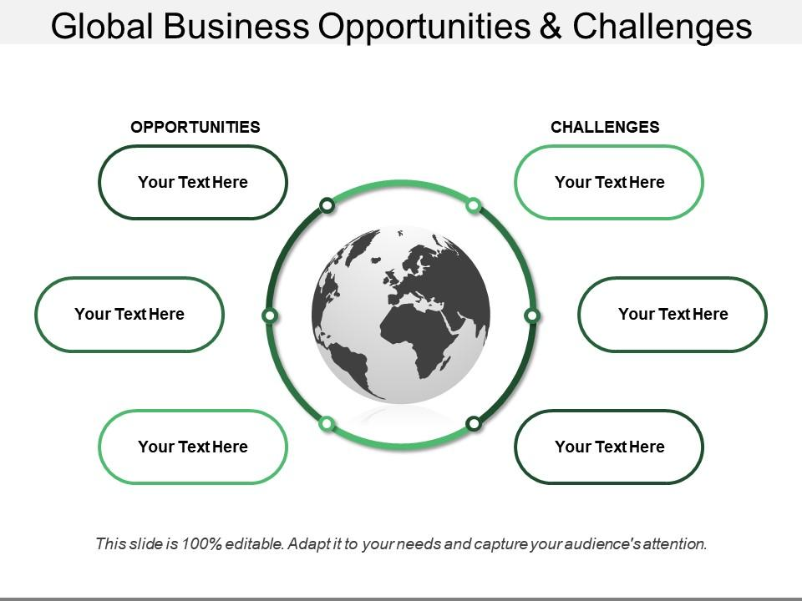
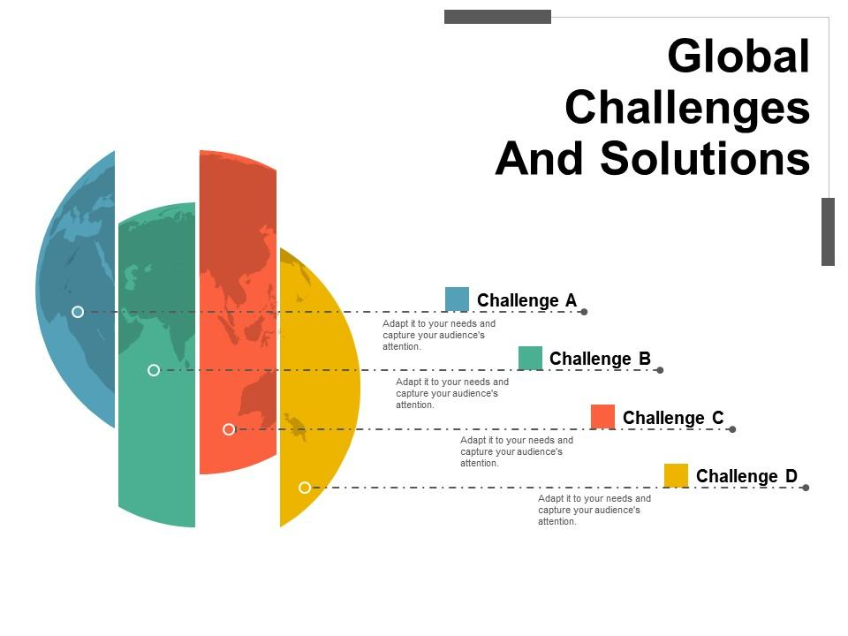
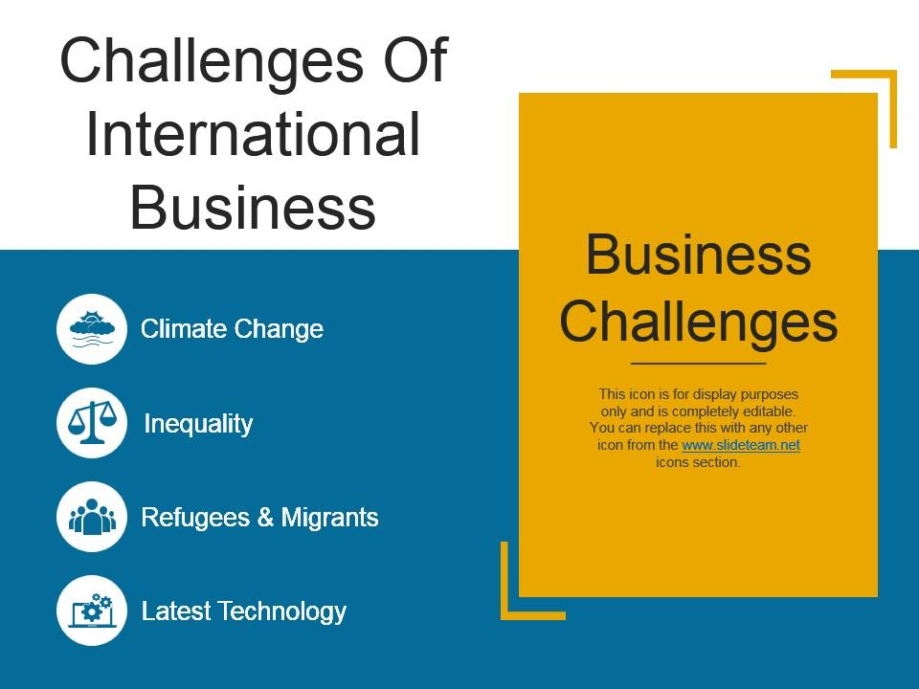
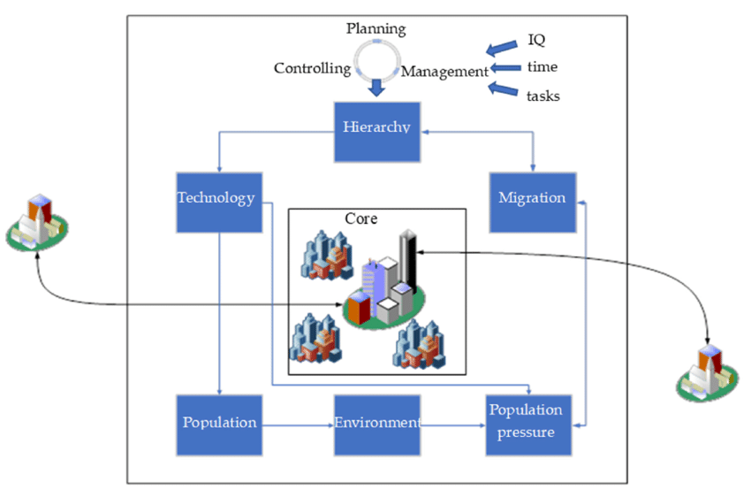
Global Business : Opportunites and challenging a connected world
Jinia Afrin Jolia
Department of Accounting & Information Systems,
University of Barishal
Email: jiniaafrinjuli@gmail.com
1. Introduction
2. Problem statement
Global business in a connected world provides opportunities for market expansion, innovation, and access to diverse resources. However, it also presents challenges like navigating different regulations, cultural differences, and managing global risks such as political instability and supply chain disruptions.
Risks from changing political climates and policies. Unpredictable exchange rates affecting profits.
Vulnerabilities in global supply chains.
Tariffs and restrictions complicating trade.
Uneven access to technology and infrastructure.
Managing sustainability and ethical standards globally.
3.Solution
4. Opportunities in Global Business
5. Challenges in Global Business
Access to new markets and customer bases.
Benefits of diversification and risk management.
Collaboration and partnerships across borders.
Innovation through global talent and resources.
Cultural differences and communication barriers.
Regulatory and compliance issues in different countries.
Economic fluctuations and political instability.
Supply chain complexities and logistics.
6.Relation
7.Future Trends
Predictions for the future of global business.
Emerging markets and industries.
The role of Al and automation in shaping business strategies
8. Conclusion
The key takeaways on navigating the opportunities and challenges in global business.Feel free to adapt these topics to align with your specific focus or audience!

